Slide 1
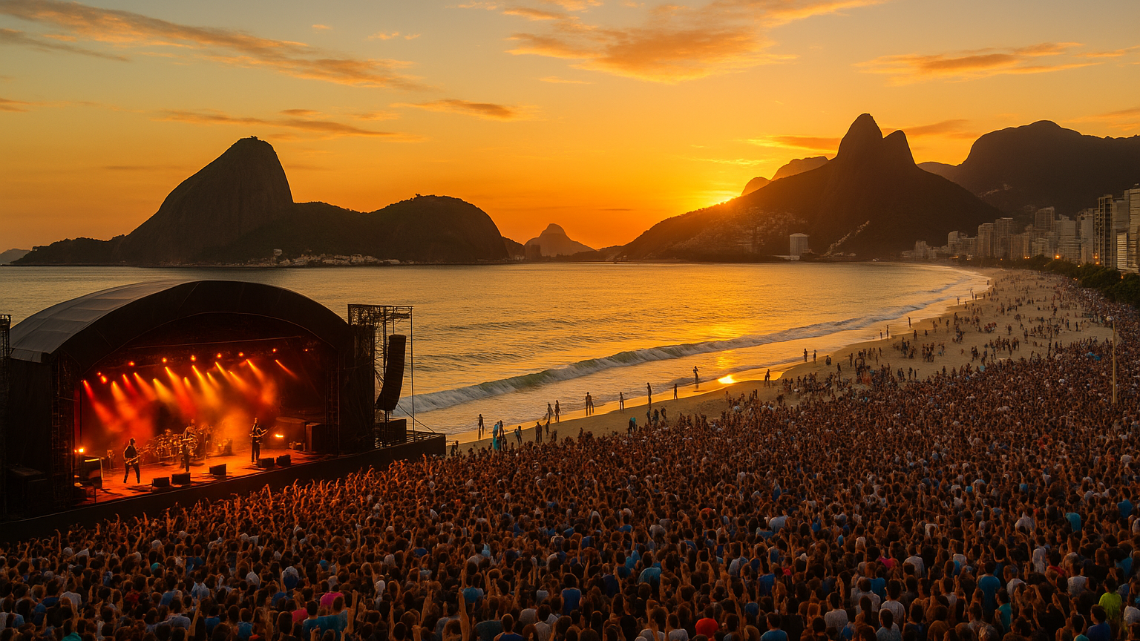
Galaxy
On-Tour
Explore and experience the world…
Landing page. The apps public name will be On-Tour. I have bought the on-tour.ai domain
Discover amazing concerts and plan and customize perfect trips to see your favorite artists.
We use a deep understanding of how you like to travel and the artists you love to make sure you never miss a show and to discover events happing wherever your travels take you.
Login
Sign Up

Slide 2
Slides 2-6 are the onboarding flow.
Color scheme is suggested not mandatory. Background should be a gradient of colors. This is an example, doesn’t have to be exactly this. I would like the color scheme for background to vary over the course of the day. Morning should be dawn like colors, midday should be bright, afternoon dusk colors, night dark colors. Other page components should vary too so that they are visible/contrast on the page
Combined personal info and location. Location is an attribute of personal info
Your Information
Interests
Travel Preferences
Communication Preferences
Let’s Go!
First Name *
Last Name *
Email *
Phone Number *
Street Address *
Apartment, suite etc. (optional)
City *
State *
Zip Code *
Country *
Back
Next

Slide 3
Reordered navigation
Add additional services to add. Maybe need to abstract this process
Your Information
Interests
Travel Preferences
Account Preferences
Let’s Go!
How would you like to set you interests?
Connect your streaming services? (recommended)
I’ll add them manually
Both – I’ll connect and add manually
Connect Spotify
Connect Apple Music
Connect YouTube
Connect
Other
Favorite Artists
Favorite Genres
Back
Next

Slide 4
Your Information
Interests
Travel Preferences
Account Preferences
Let’s Go!
Keep existing fields and navigation
Back
Next

Slide 5
Add ability to choose communication preferences. SMS, Push, email. How often you want communications.
How many suggested trips.
Site preferences, i.e. light versus dark mode
Any other relevant account settings
Your Information
Interests
Travel Preferences
Account Preferences
Let’s Go!
Back
Next

Slide 6
Your Information
Interests
Travel Preferences
Communication Preferences
Let’s Go!
Keep existing fields and navigation
Back
Next

